Slide 1


CAPSTONE PROJECT
TechCrush Capstone Project
CAPSTONE PROJECT TOPIC 3
APPLYING CRYPTOGRAPHY
Disclaimer: This training material belongs to techcrush and shouldn’t be shared

Slide 2
CAPSTONE PROJECT
Outline
TITLE
AIM AND OBJECTIVE
METHODOLOGY
CONCEPT OF PROJECT
TOOLS USED
IMAGES
TASK 3.1 Data Protection With Encryption
TASK 3.2 Hashing and Integrity Checking
TASK 3.3 Public key Encryption - Secure messaging
TASK 3.4 Scenario Simulation : File verification system
OVERALL SUMMARY
CONCLUSION
REFERENCES
THANK YOU
Disclaimer: This training material belongs to techcrush and shouldn’t be shared

Slide 3
CAPSTONE PROJECT
Title
Applying Cryptography in Real-World Scenarios:
Data Protection with Encryption
Hashing and Integrity Checking
Public Key Encryption / Secure Messaging
File Verification System: Use hashes to verify if downloaded files are safe.
Disclaimer: This training material belongs to techcrush and shouldn’t be shared

Slide 4
CAPSTONE PROJECT
Aim
To understand and demonstrate how cryptography protects data in everyday systems by implementing practical simulation which ensures data confidentiality, file integrity, and authenticity.
Objectives
Master Encryption Techniques to protect data confidentiality using AES and RSA algorithms.
Generate and verify cryptographic hashes to detect file tampering.
Demonstrate Digital Signatures using public/private key pairs to prove authenticity.
Simulate real-world cases for secure messaging and file verification.
Disclaimer: This training material belongs to techcrush and shouldn’t be shared

Slide 5
CAPSTONE PROJECT
Methodology
Practical exercises using standard cryptographic tools
Comparative Analysis by testing different algorithms (AES, RSA, SHA-256, SHA-512, MD5)
Tampering Detection: Simulating security breaches to verify cryptographic protections
Scenarios: Applying techniques to file verification, secure messaging, and data storage
Recording hash values, encryption keys, and verification results
Following guidelines for key management and algorithm selection
Disclaimer: This training material belongs to techcrush and shouldn’t be shared

Slide 6
CAPSTONE PROJECT
  Concept of project
This project focuses the CIA Triad: file integrity, authenticity, and security.
It highlights the sensitivity of hash functions and the importance of digital signatures in cybersecurity.
Disclaimer: This training material belongs to techcrush and shouldn’t be shared

Slide 7
CAPSTONE PROJECT
Cryptographic Techniques
Symmetric Encryption (AES): Same key for encryption and decryption
Asymmetric Encryption (RSA): Public key encrypts, private key decrypts
Hashing (SHA-256/512, MD5): One-way fingerprinting for integrity
Digital Signatures: Combining hashing and asymmetric encryption
Disclaimer: This training material belongs to techcrush and shouldn’t be shared

Slide 8
CAPSTONE PROJECT
Tools Used
VeraCrypt
Purpose: Create encrypted file containers using AES-256
Features: Symmetric encryption, SHA-512 hashing, PBKDF2 key derivation
HashCalc
Purpose: Generate and compare hash values for file integrity
Features: MD5, SHA-256, SHA-512 hash generation
CyberChef
Purpose: RSA signing and verification of digital signatures
Features: RSA Sign/Verify, Base64 encoding/decoding
RSA Key Generator
Purpose: Generate public-private key pairs for asymmetric encryption
Features: 2048-bit RSA key pair generation
Disclaimer: This training material belongs to techcrush and shouldn’t be shared

Slide 9
CAPSTONE PROJECT
Task 1: Data Protection with Encryption
Objective
To create encrypted file containers using VeraCrypt with AES symmetric encryption
Process
1.Created 10MB encrypted container using VeraCrypt
2.Selected AES encryption algorithm with SHA-512 hashing
3.Used Password-Based Key Derivation Function 2 (PBKDF2) for password strengthening
4.Mounted container as virtual drive for file storage
5.Tested encryption by mounting and dismounting the container
Outcome
Successfully protected files using symmetric encryption, demonstrating confidentiality through AES, integrity through SHA-512, and authenticity through password-based access control
CIA Protection: Confidentiality (AES), Integrity (SHA-512), Authenticity (Password)
Disclaimer: This training material belongs to techcrush and shouldn’t be shared

Slide 10
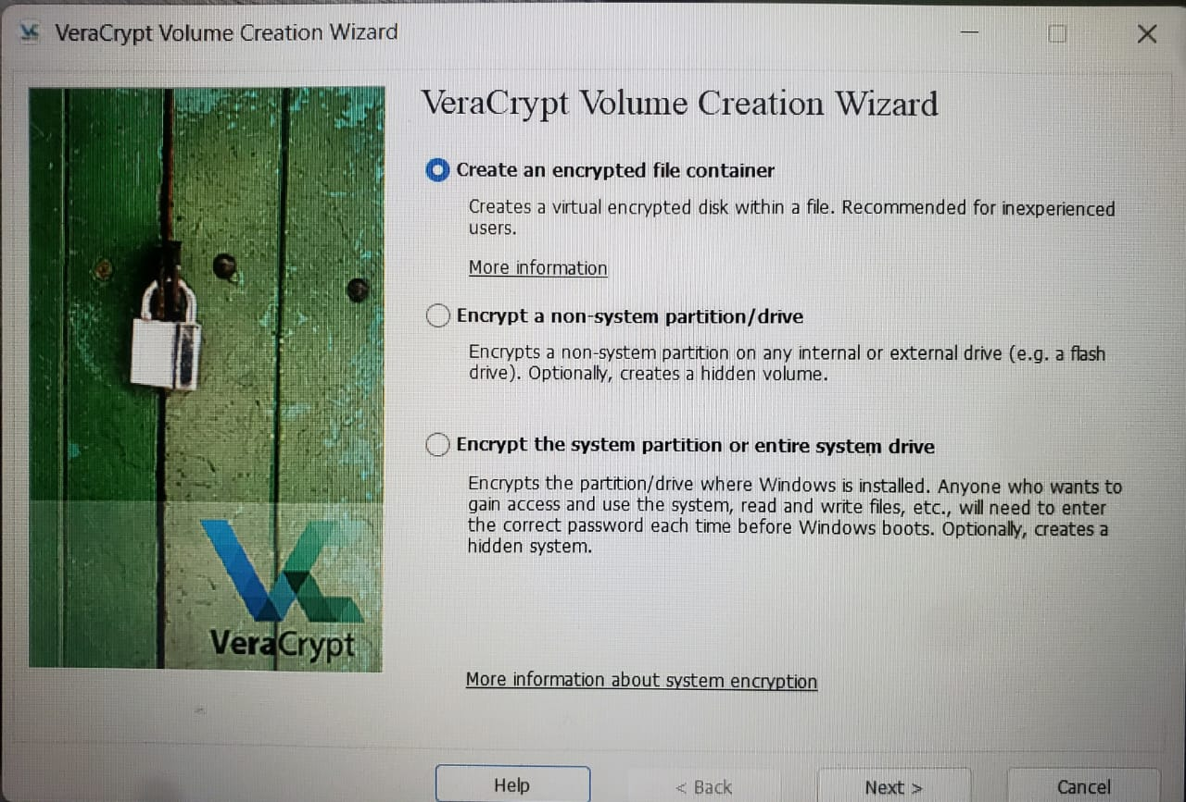
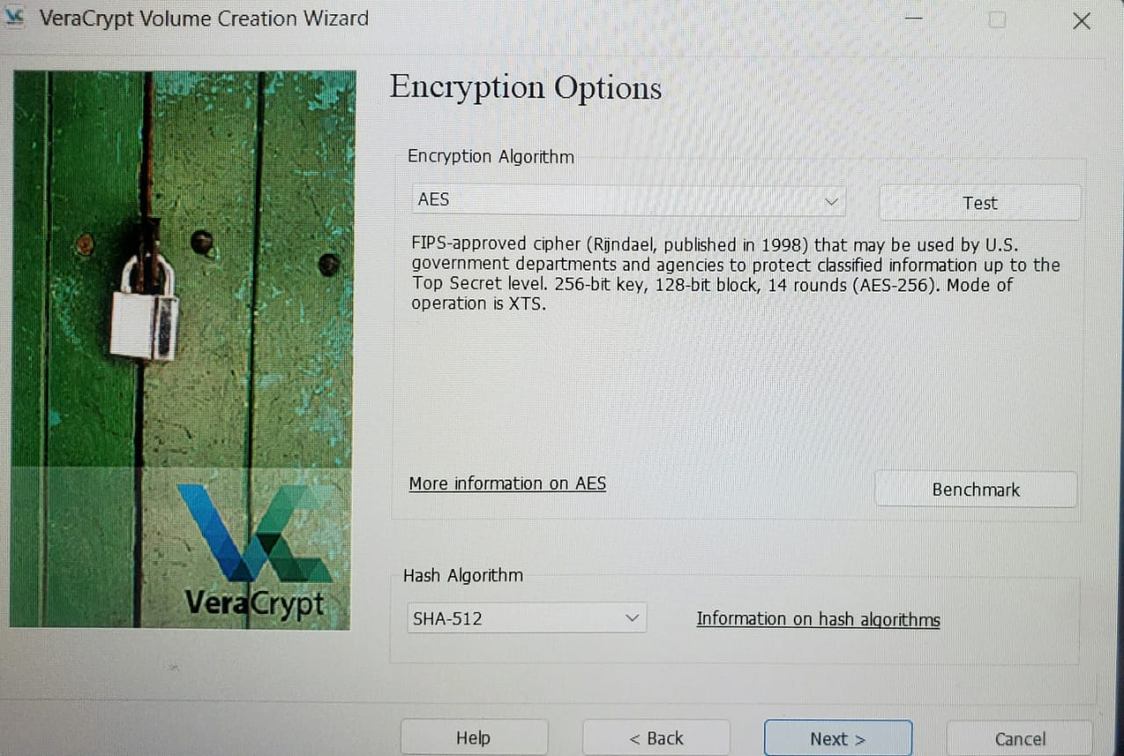
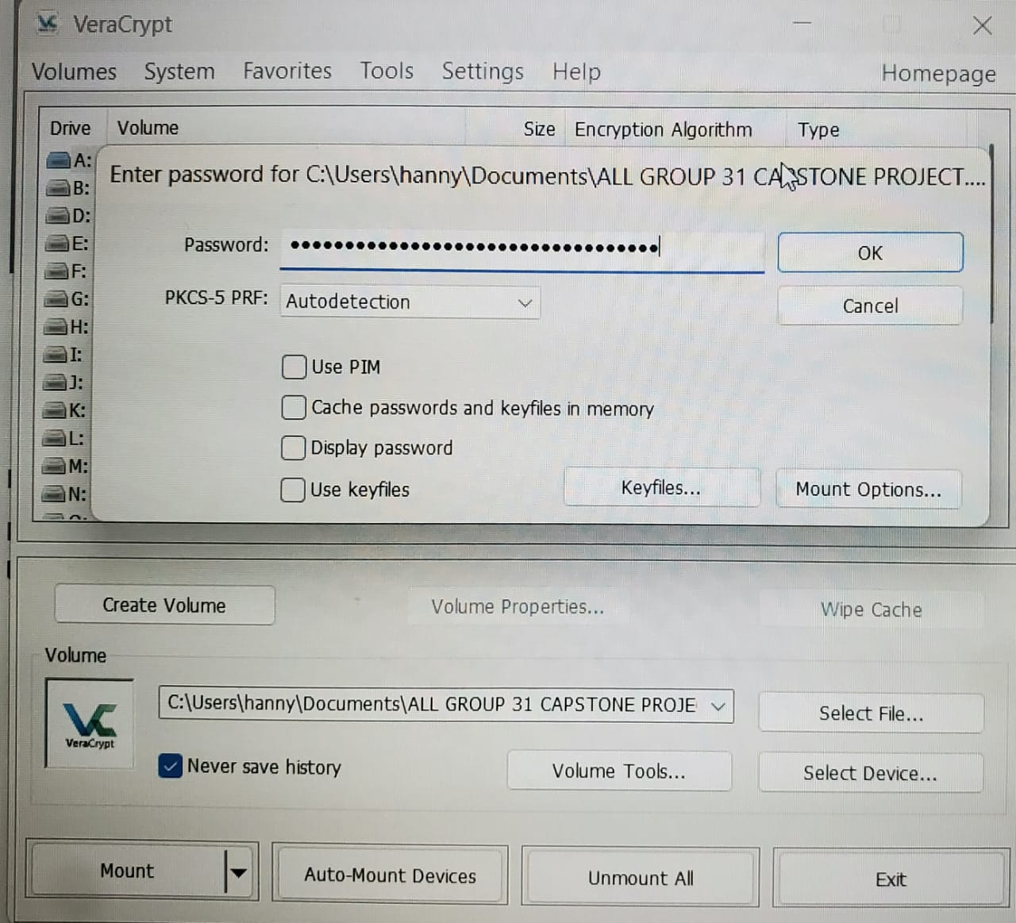
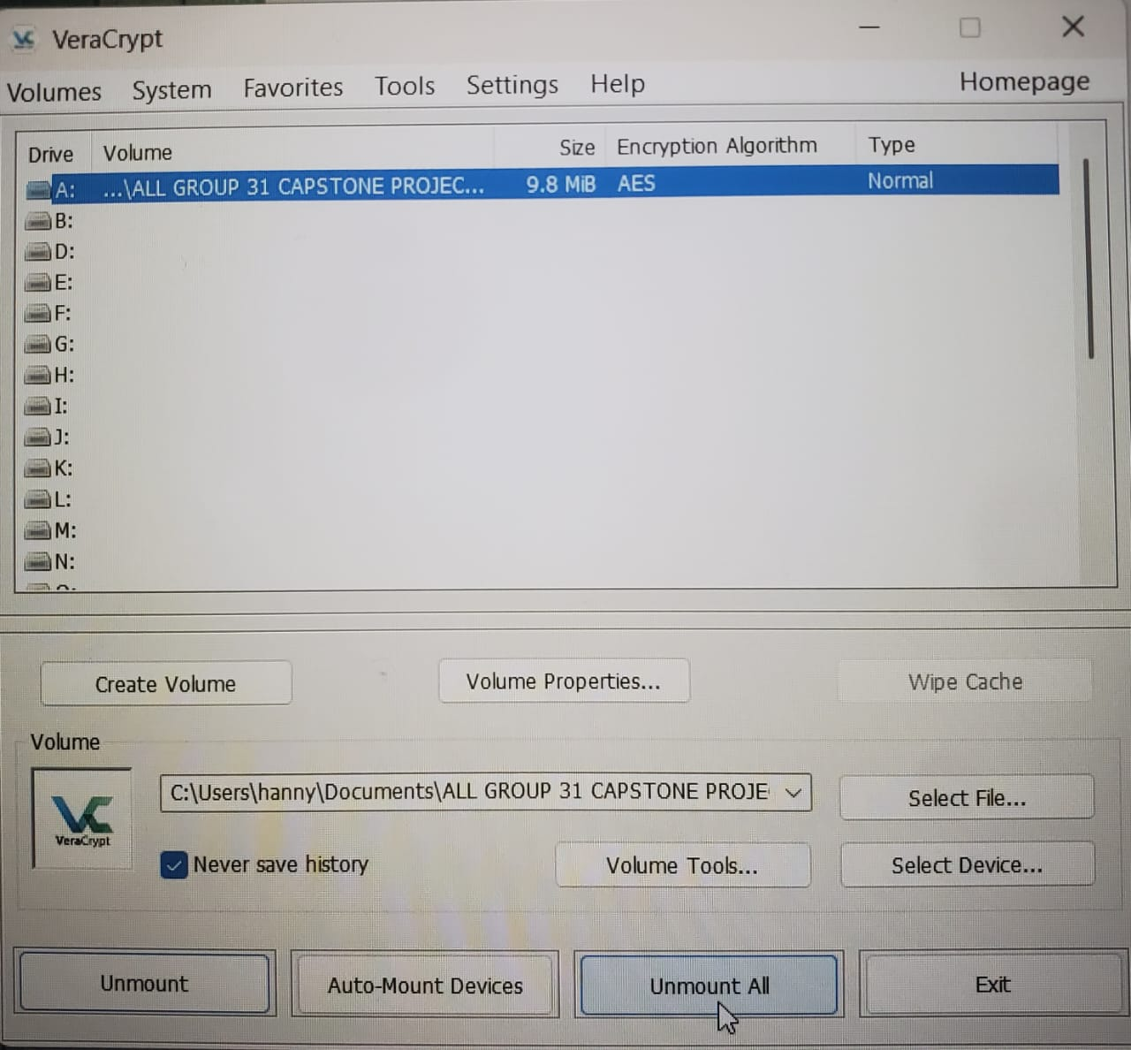
CAPSTONE PROJECT
Task 1: Data Protection with Encryption Cont’d
Disclaimer: This training material belongs to techcrush and shouldn’t be shared

Slide 11
CAPSTONE PROJECT
Task 2: Hashing and Integrity Checking
Objective
Use SHA-256 hashing to verify file integrity and detect tampering
Process
1.Generated SHA-256 hash values for original files using Hash Checker
2.Calculated hash values for video files and documents
3.Modified files to simulate tampering
4.Regenerated hash values and compared with originals
5.Documented complete hash value changes after minimal modifications
Outcome
Demonstrated that even minor file changes produce completely different hash values, proving hashing is effective for integrity verification in software distribution, backups, and blockchain
CIA Protection: Integrity (SHA-256 hashing)
Disclaimer: This training material belongs to techcrush and shouldn’t be shared

Slide 12
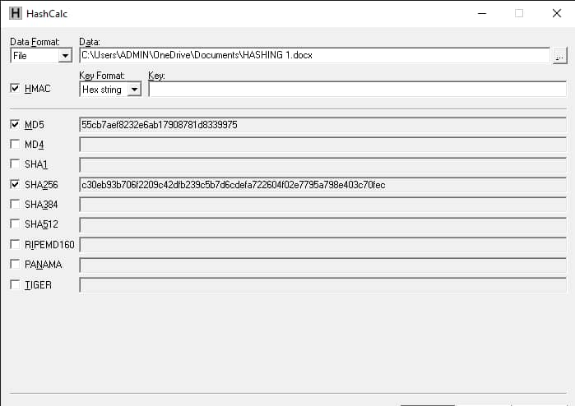
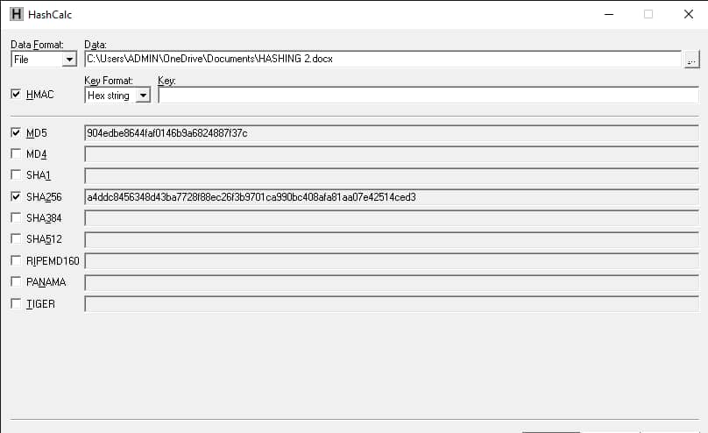
CAPSTONE PROJECT
Task 2: Hashing and Integrity Checking Cont’d
Screenshot of the original hash value created
Screenshot shows hash values are different from the previous one hash values
Disclaimer: This training material belongs to techcrush and shouldn’t be shared

Slide 13
CAPSTONE PROJECT
Task 3: Public Key Encryption - Secure Messaging
Objective
Implement asymmetric encryption using RSA for secure communication
Process
1.Generated 2048-bit RSA key pair (public and private keys)
2.Used CyberChef RSA Encrypt with public key to encrypt plaintext message
3.Converted plaintext to ciphertext (unreadable encrypted format)
4.Used RSA Decrypt with private key to recover original message
5.Verified that only the private key holder can decrypt messages
Outcome
Successfully demonstrated asymmetric encryption where public keys can be shared freely for encryption while private keys remain secret for decryption, ensuring confidential communication
CIA Protection: Confidentiality (RSA), Integrity (SHA-256), Authenticity (Digital Signatures)
Disclaimer: This training material belongs to techcrush and shouldn’t be shared

Slide 14
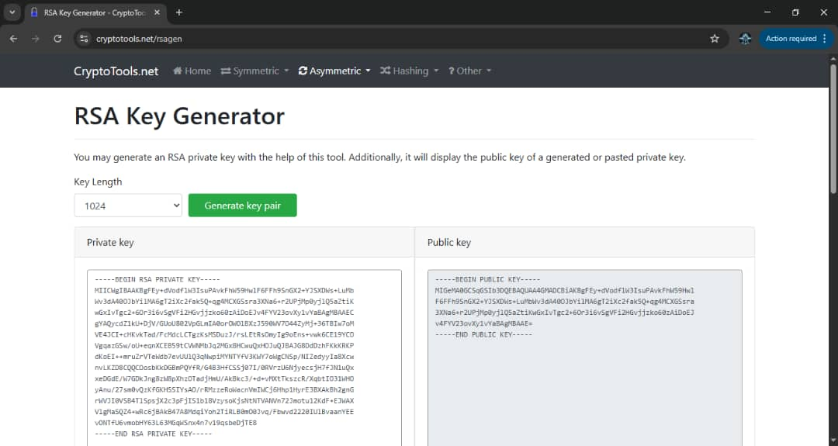
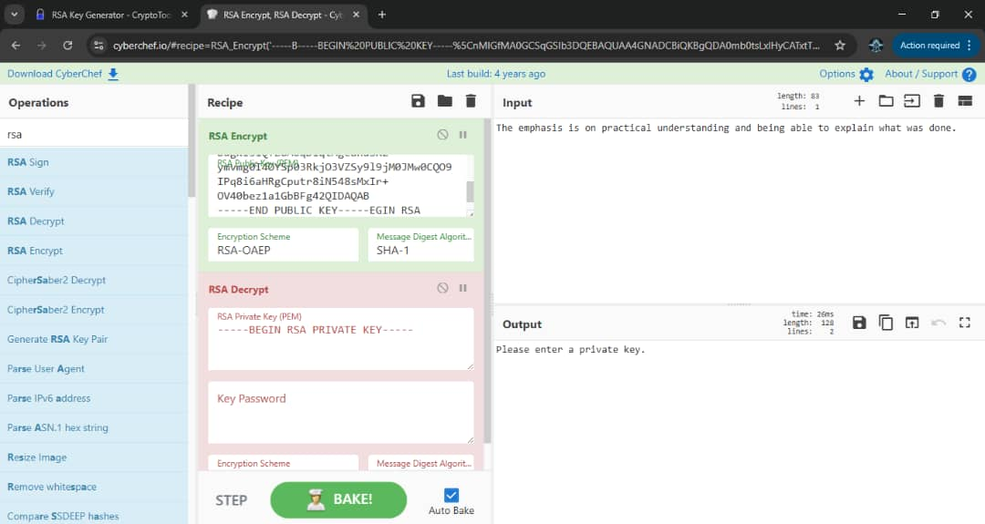
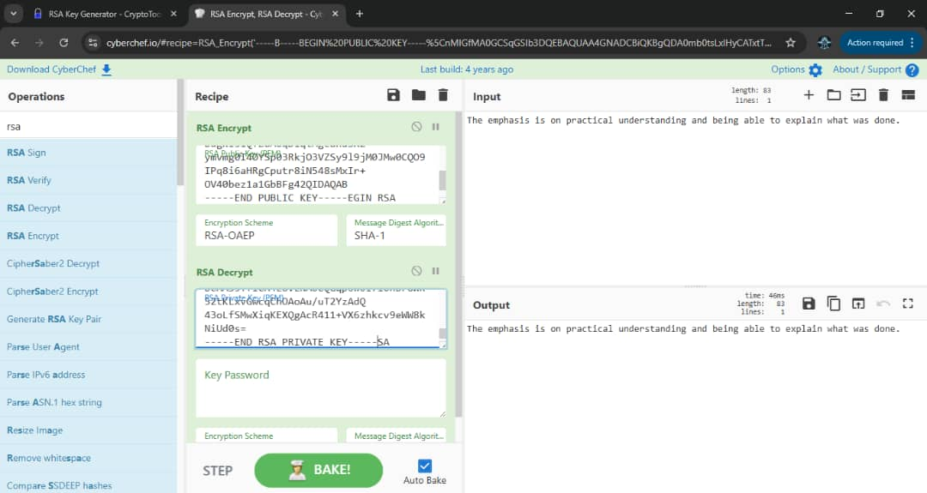
CAPSTONE PROJECT
Task 3: Public Key Encryption - Secure Messaging Cont’d
RSA public and private keys
RSA encrypt takes the plaintext input and a public key to produce and RSA encrypted cipher text.
Private key from the RSA Key generator is entered into the RSA DECRYPT tab to decrypt message.
Disclaimer: This training material belongs to techcrush and shouldn’t be shared

Slide 15
CAPSTONE PROJECT
Task 4: Scenario Simulation - File Verification
Objective
Combine hashing and digital signatures for comprehensive file verification
Process
1.Part 1 - Hashing: Generated MD5, SHA-256, SHA-512 hashes for files, modified one character, and detected complete hash changes
2.Part 2 - Digital Signatures: Created RSA key pair, signed file with private key and SHA-256, verified signature with public key
3.Part 3 - Tampering Detection: Modified signed message and demonstrated verification failure
4.Combined techniques to protect both integrity and authenticity
Outcome
Proved that hashing detects any file tampering while digital signatures verify both the sender's identity and file integrity, essential for software distribution and secure communications
CIA Protection: Integrity (Hashing), Authenticity & Integrity (Digital Signatures)
Disclaimer: This training material belongs to techcrush and shouldn’t be shared

Slide 16
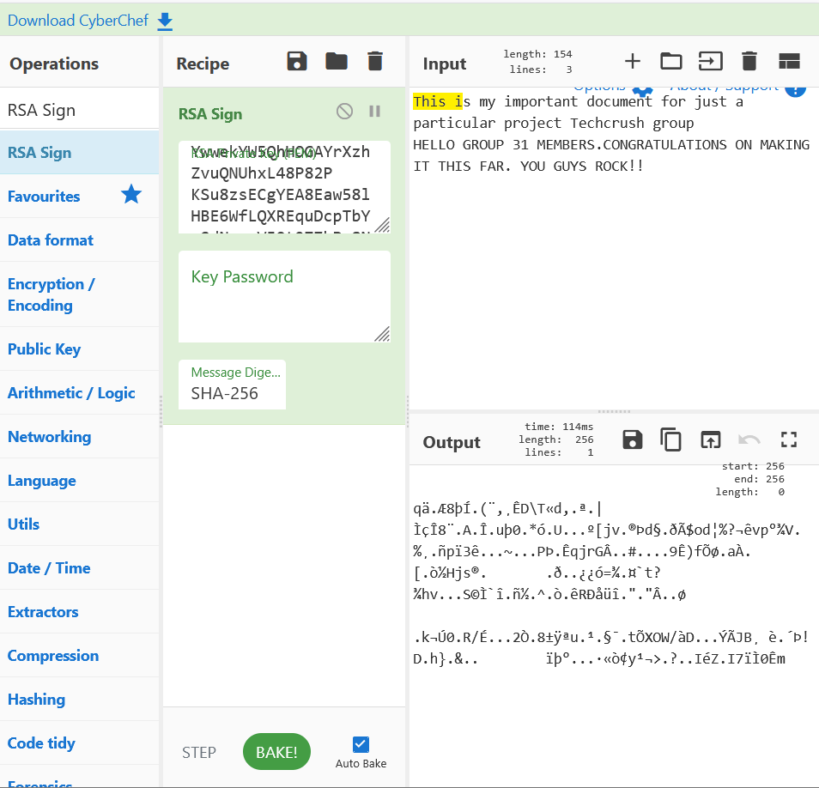
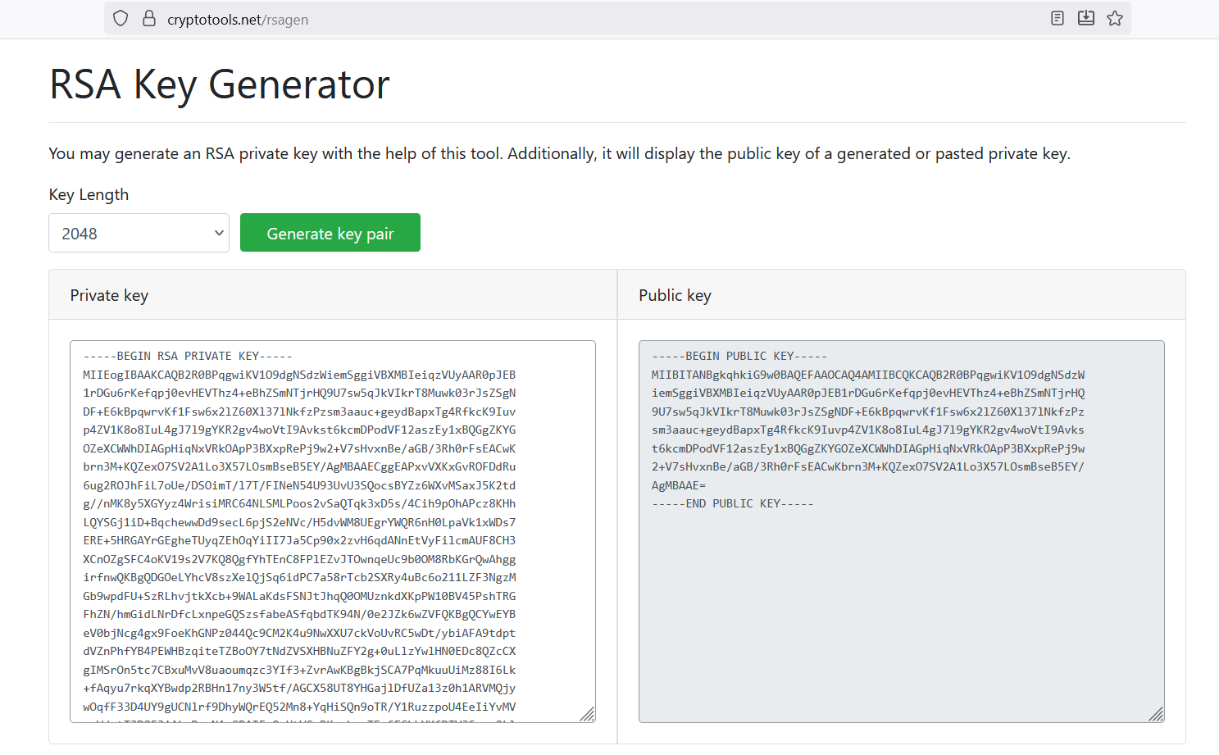
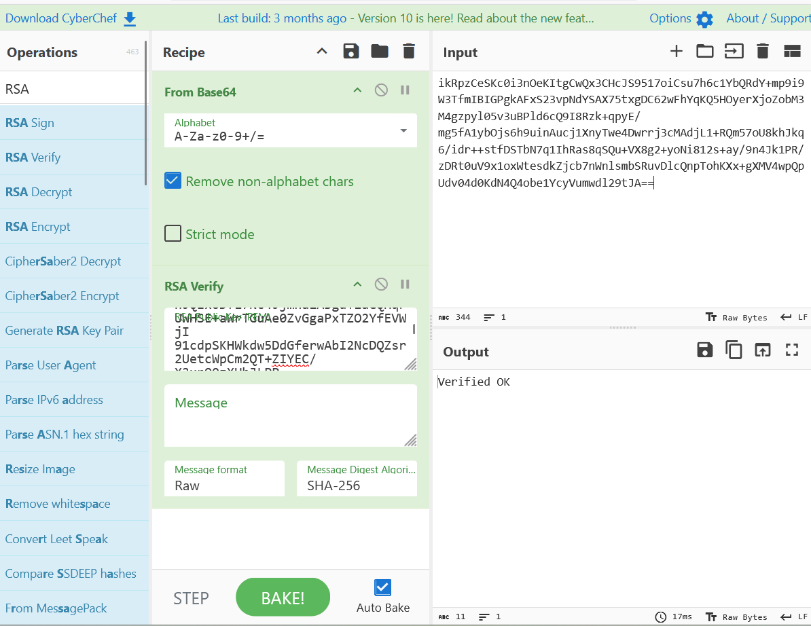
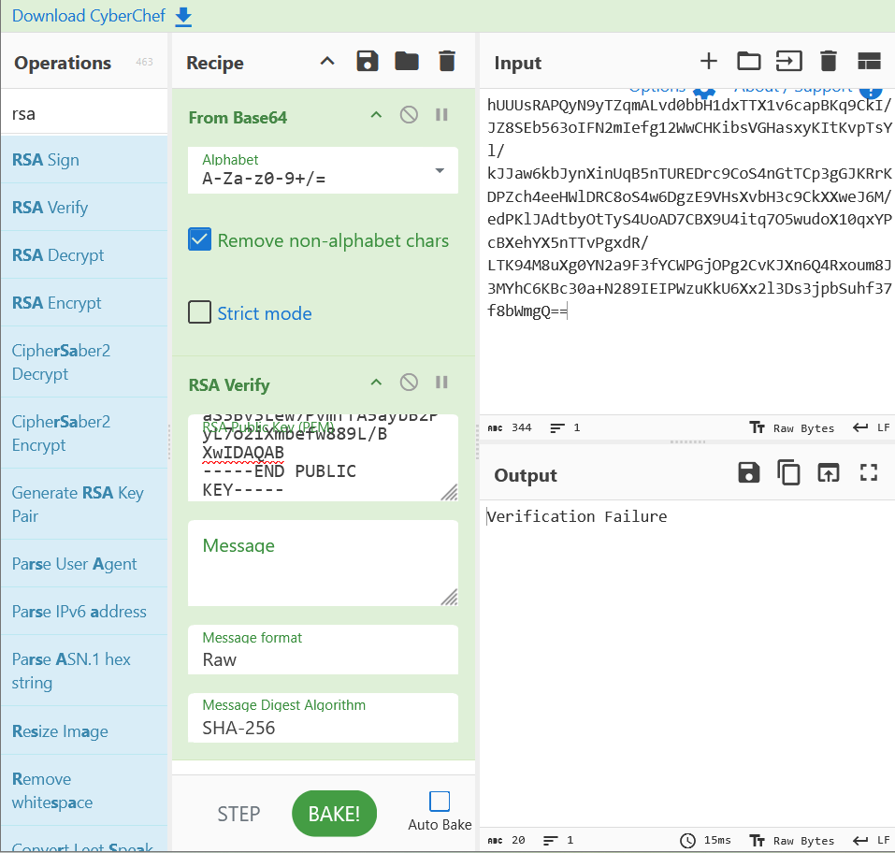
CAPSTONE PROJECT
Task 4: Scenario Simulation - File Verification Cont’d
Private & Public Key Generation
Using private key, sha-256 & input msg produced output :Your digital signature
Shows ‘Verified OK’: This proves that file hasn’t been compromised
Verification Failure’ This proves the file has been compromised
Disclaimer: This training material belongs to techcrush and shouldn’t be shared

Slide 17
CAPSTONE PROJECT
Key Results and Observations
Hash Sensitivity
Changing a single character in a file produces completely different hash values across MD5, SHA-256, and SHA-512
Encryption Effectiveness
AES-256 encryption made files completely inaccessible without correct password; mounting/dismounting process secured data
Asymmetric Security
RSA public-private key pairs enabled secure one-way encryption where anyone can encrypt but only key holder can decrypt
Digital Signature Verification
Signatures verified authenticity and integrity; tampering caused immediate verification failure
Algorithm Performance
SHA-256 offers best balance of security and speed; MD5 and SHA-1 are deprecated; RSA operations are computationally intensive
Disclaimer: This training material belongs to techcrush and shouldn’t be shared

Slide 18
CAPSTONE PROJECT
Overall Summary
Cryptographic Techniques Implemented
Successfully applied symmetric encryption (AES), asymmetric encryption (RSA), hashing (SHA-256/512, MD5), & digital signatures
CIA Triad Coverage
Confidentiality through encryption, Integrity through hashing, and Authenticity through digital signatures and password protection
Real-World Applications
These techniques are essential for secure messaging, banking applications, password storage & compliance with security standards like GDPR and HIPAA
Key Learnings
Security requires multiple techniques working together, no single method protects all aspects; key management is critical, modern algorithms must be used, verification is essential before trusting any data
Disclaimer: This training material belongs to techcrush and shouldn’t be shared

Slide 19
CAPSTONE PROJECT
Challenges and Solutions
Challenge:
      Key Management Complexity
      Performance Impact on Large Files
      Trust and Verification
      Algorithm Obsolescence
Solution:
Use password managers and hardware security keys
Hash files instead of encrypting entire content for signatures
Verify public keys through trusted authorities & always check hashes
Use SHA-256/SHA-512/SHA-3 instead of SHA-1; use RSA-2048 minimum instead of RSA-1024
Disclaimer: This training material belongs to techcrush and shouldn’t be shared

Slide 20
CAPSTONE PROJECT
Real-World Security Applications
Software Security
Verifying downloaded files match official hashes
Digital signatures on software updates, Secure patch deployment.
Financial Systems
Banking app encryption for account details
Password hashing for authentication
Digital signatures for transaction verification
Data Compliance
Meeting GDPR, HIPAA, and ISO 27001 requirements
Audit trail integrity verification, Secure cloud storage encryption
Disclaimer: This training material belongs to techcrush and shouldn’t be shared

Slide 21
CAPSTONE PROJECT
Conclusion
Understanding file integrity and security is crucial in the digital age.
Continuous learning and adaptation to new threats are essential for cybersecurity.
Hashing detects any tampering; digital signatures verify both sender identity and content integrity
As cybersecurity professionals, Security is not about one perfect solution but about layering multiple protections to create comprehensive defense.
Disclaimer: This training material belongs to techcrush and shouldn’t be shared

Slide 22
CAPSTONE PROJECT
References & Resources
Tools:
CyberChef, HashCalc,
VeraCrypt
RSA Key Generator.
Standards and Algorithms
AES (Advanced Encryption Standard) - NIST FIPS 197
SHA-256/512 (Secure Hash Algorithm) - NIST FIPS 180-4
RSA (Rivest-Shamir-Adleman) - Public Key Cryptography
Security Frameworks
CIA Triad - Confidentiality, Integrity, Availability
GDPR - General Data Protection Regulation
ISO 27001 - Information Security Management
Project Files; Google drive detailed notes, screenshots and video on tasks
Data Protection with Encryption (Project 3.1)
Hashing and Integrity Checking (Project 3.2)
Public Key Encryption – Secure Messaging (Project 3.3)
Scenario Simulation – File Verification (Project 3.4)
Disclaimer: This training material belongs to techcrush and shouldn’t be shared

Slide 23
CAPSTONE PROJECT
THANK YOU
Disclaimer: This training material belongs to techcrush and shouldn’t be shared

